Slide 1
Capstone Project
The Battle of Neighborhoods

Slide 2
Introduction
Background: Many people are looking for a better city to move to due to there are high tax, high house sale prices, high house rental prices, poor housing, crowded city, educational quality declining, and poor security.
Problem: How can we tell which city will be an optimal city to move to based on these criteria? Which location of the optimal city will be the better place to live in? What popular venues are around this location? What are the houses' sale prices or rental prices around this location?

Slide 3


Which is the Optimal City?
Atlanta, GA
Raleigh, NC

Slide 4


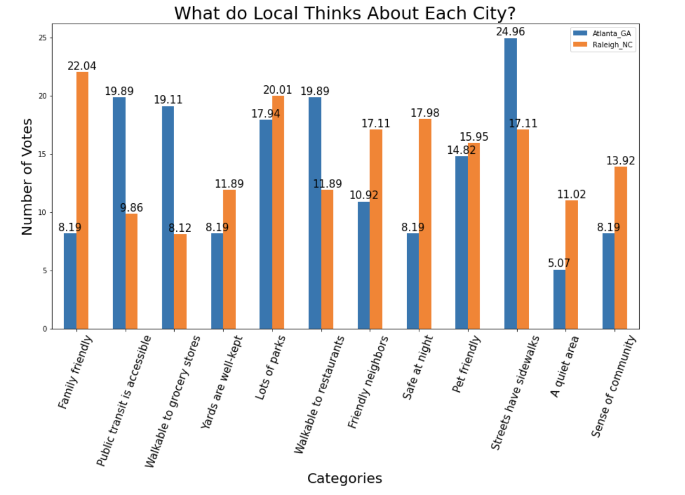

Raleigh, NC is more optimal.

Slide 5
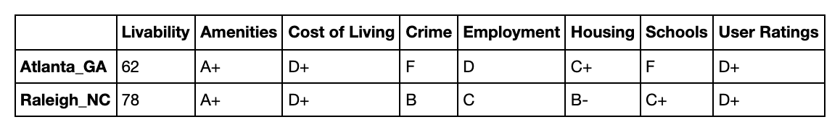
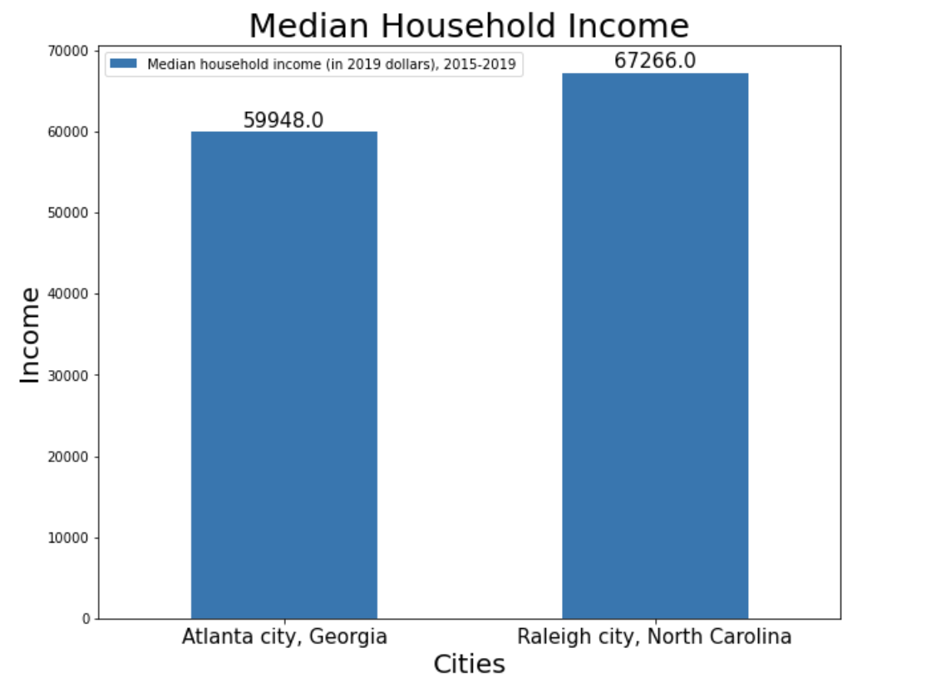
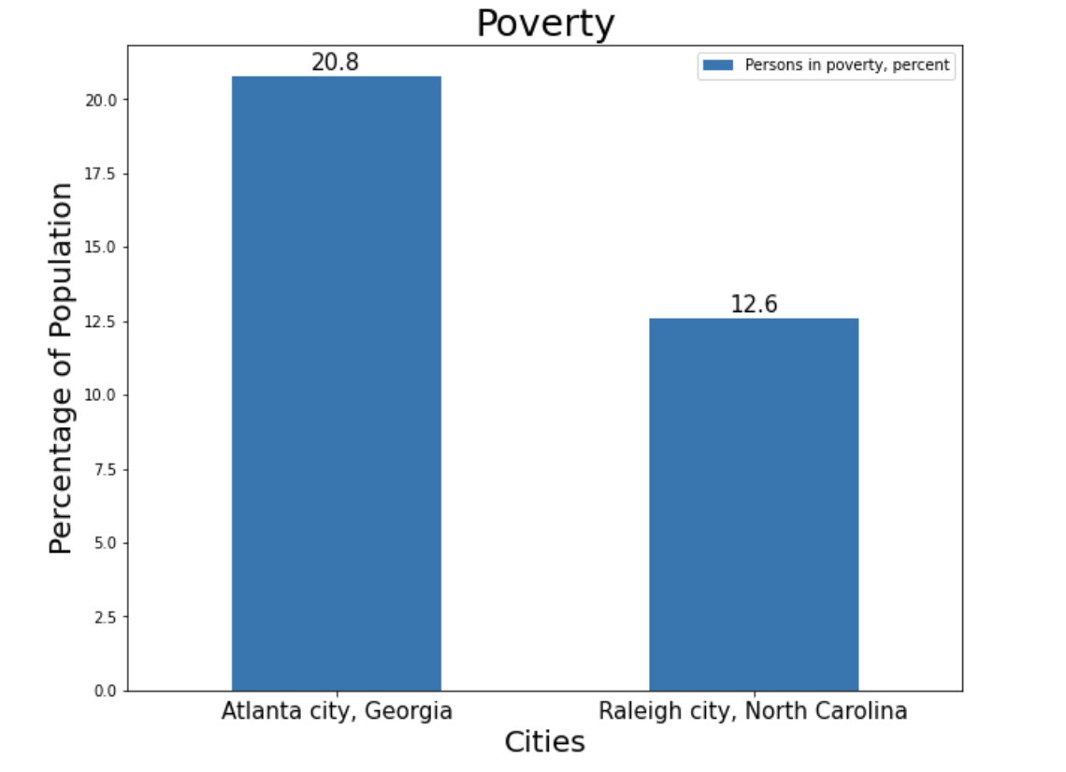
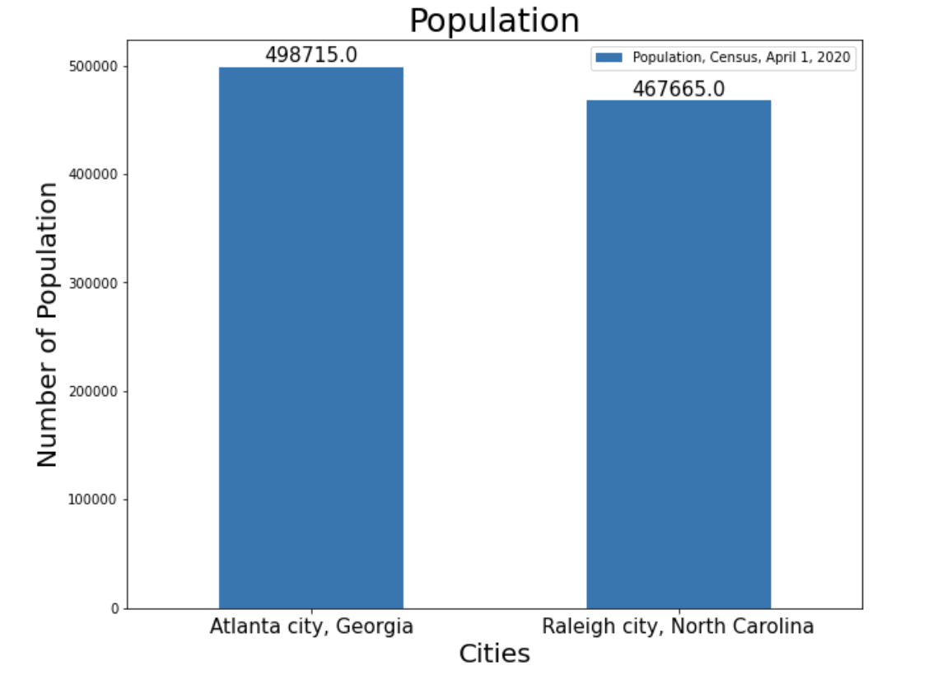
Raleigh, NC is more optimal.

Slide 6
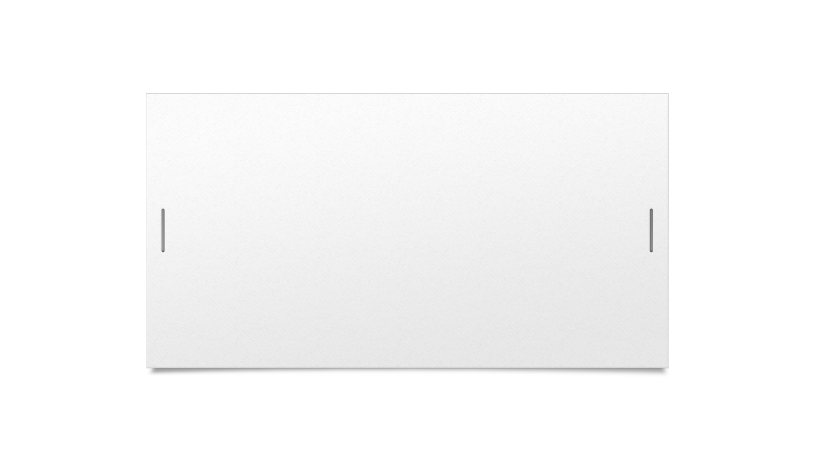
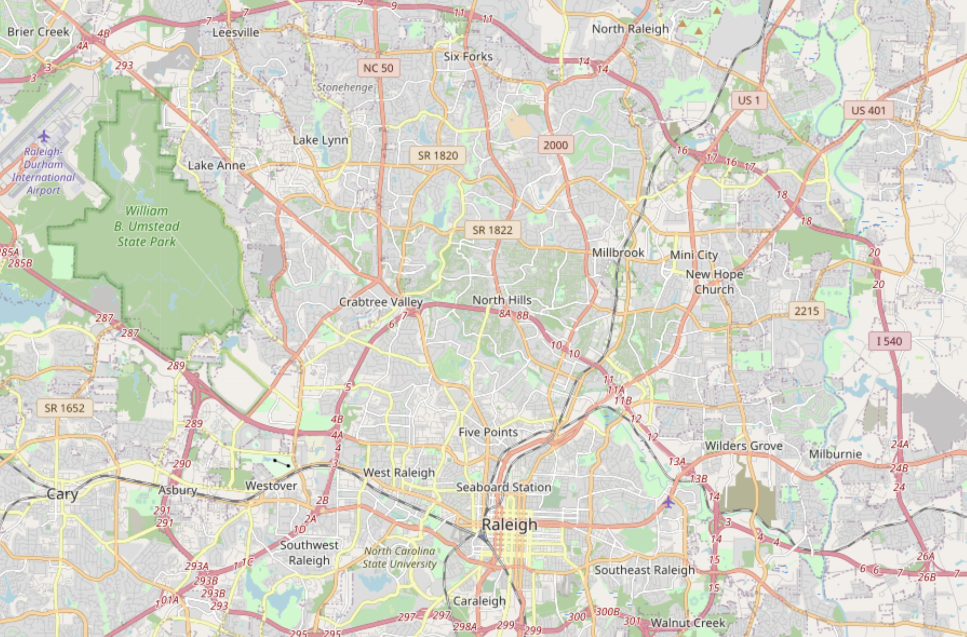

Which Area is Optimal in Raleigh City?

Slide 7
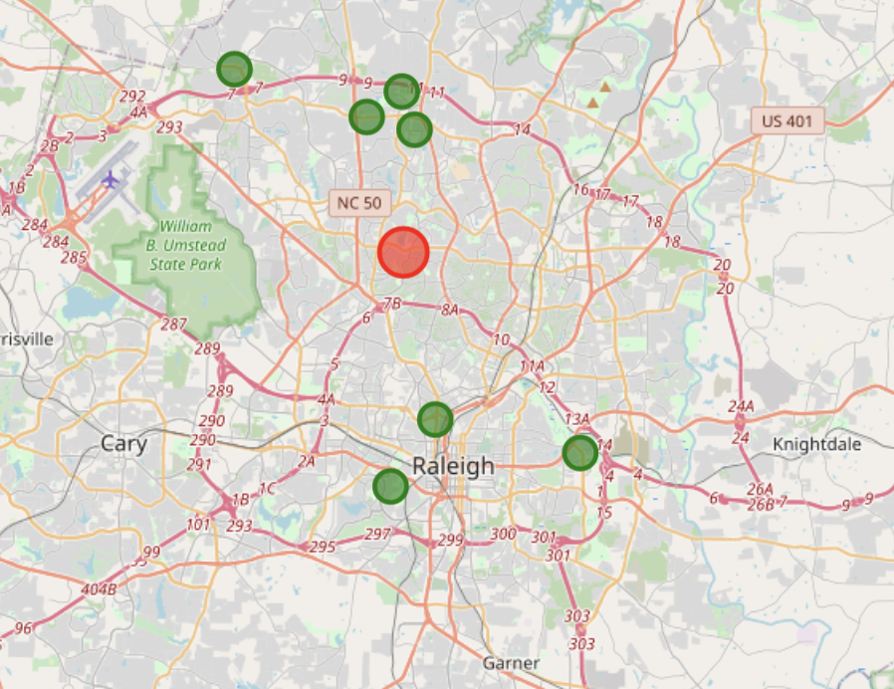
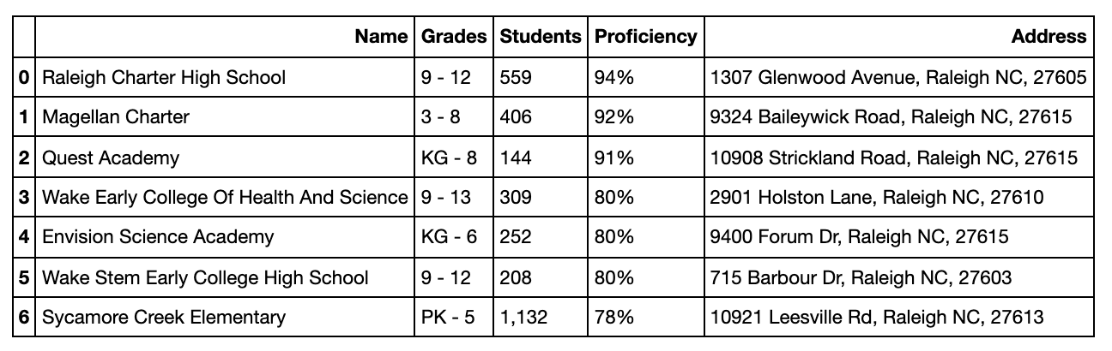
Centroid Zip 27612
Top-Rated Schools

Slide 8
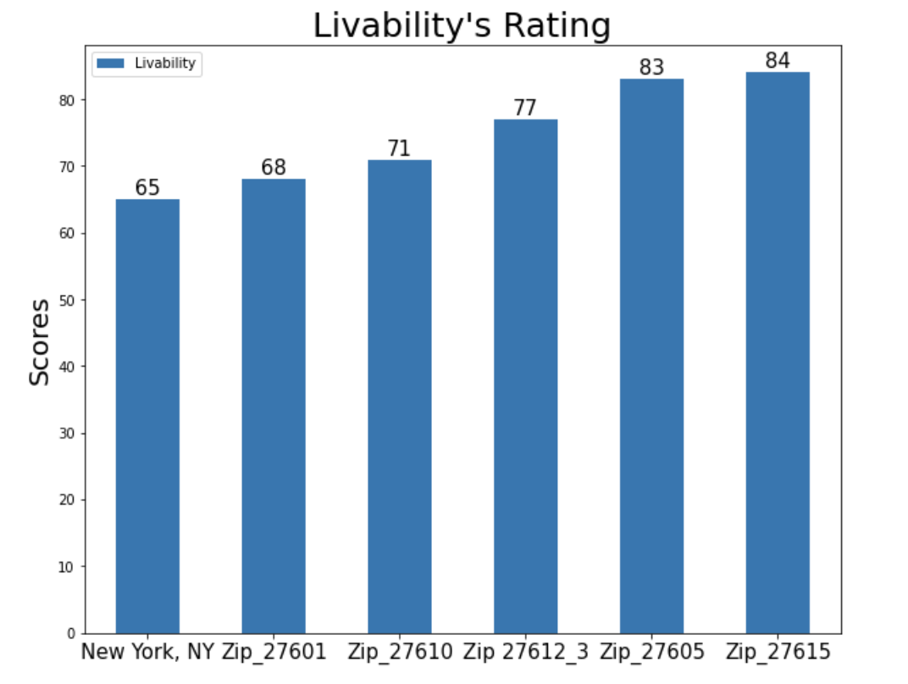
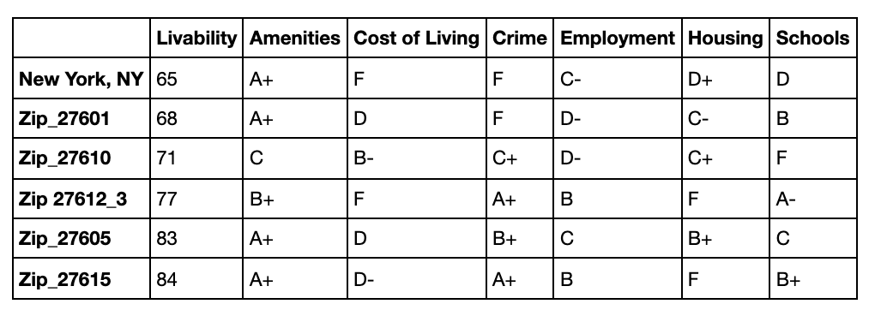
Which Area is Optimal?
Let’s take a closer look at zip 27612_3, 27605, and 27615

Slide 9
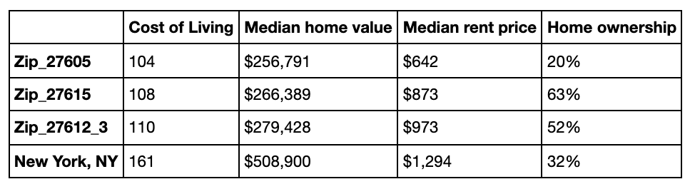
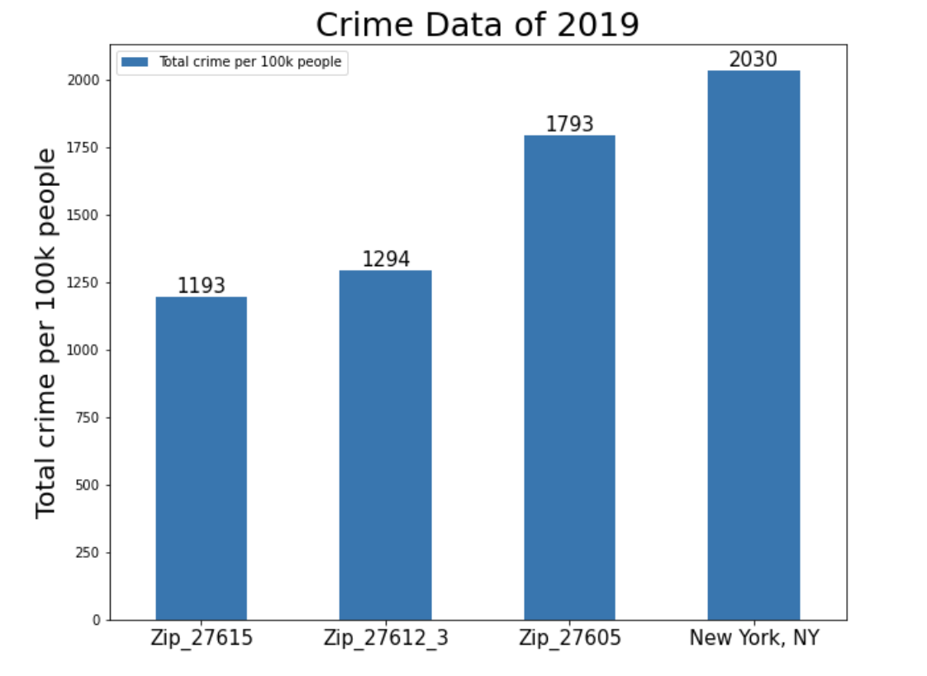
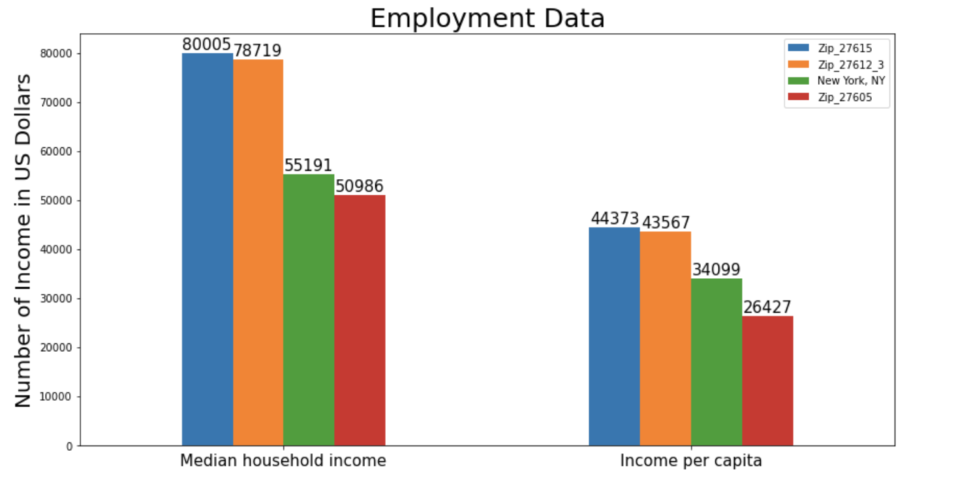
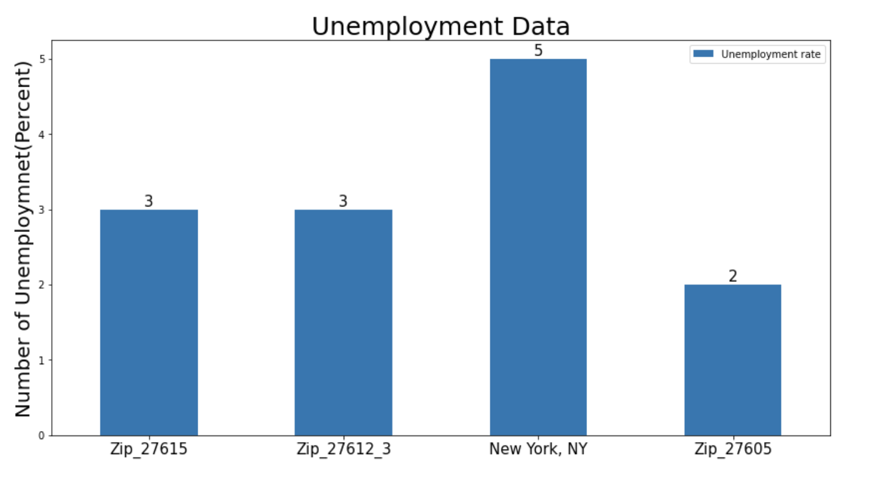
Zip 27612_3 and 27615 are most optimal areas.

Slide 10
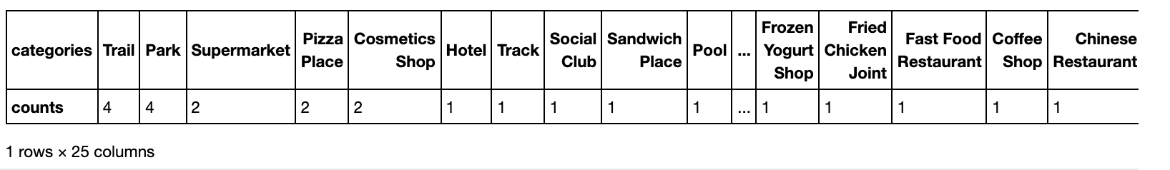
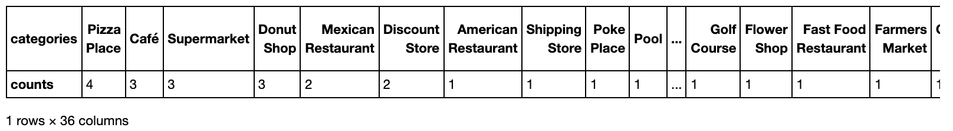
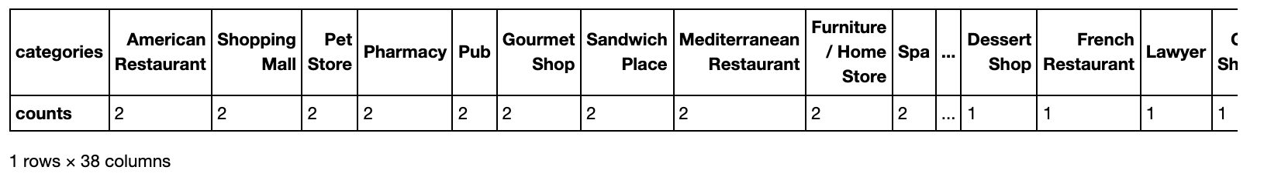
What are the Popular Spots Around These Areas?
The Most Common Venues Near This Zip Code 27612
The Most Common Venues Near This Zip Code 27613
The Most Common Venues Near This Zip Code 27615

Slide 11
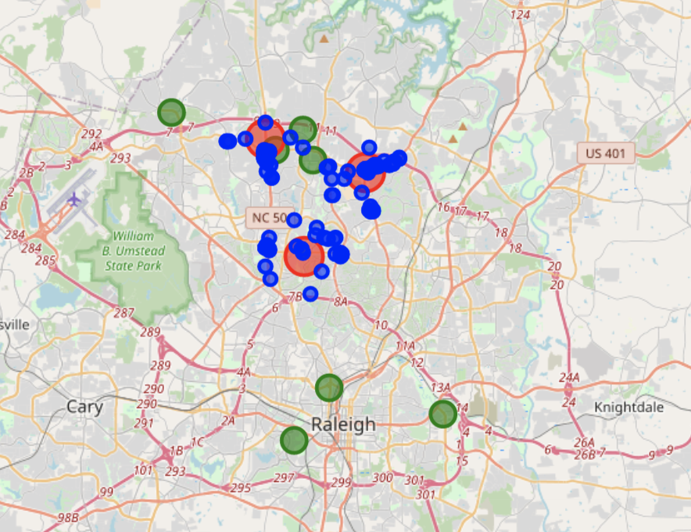
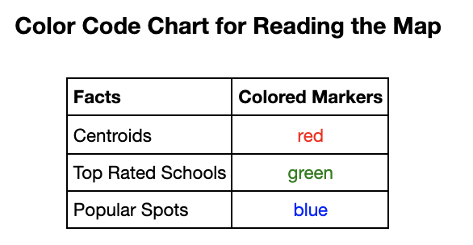
Where are the Popular Spots Around These Areas?
Zip 27613
Zip 27615
Zip 27612

Slide 12
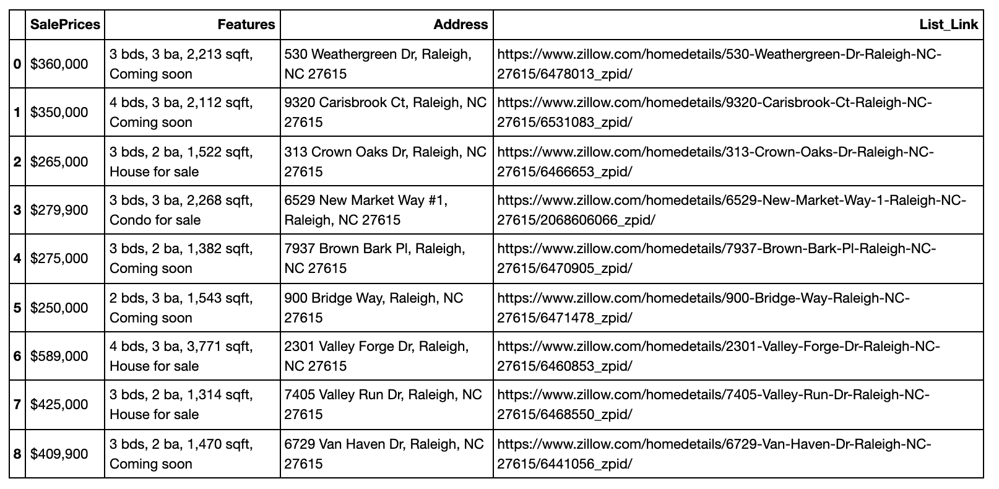
Houses for Sale Nearby Zip 27615

Slide 13
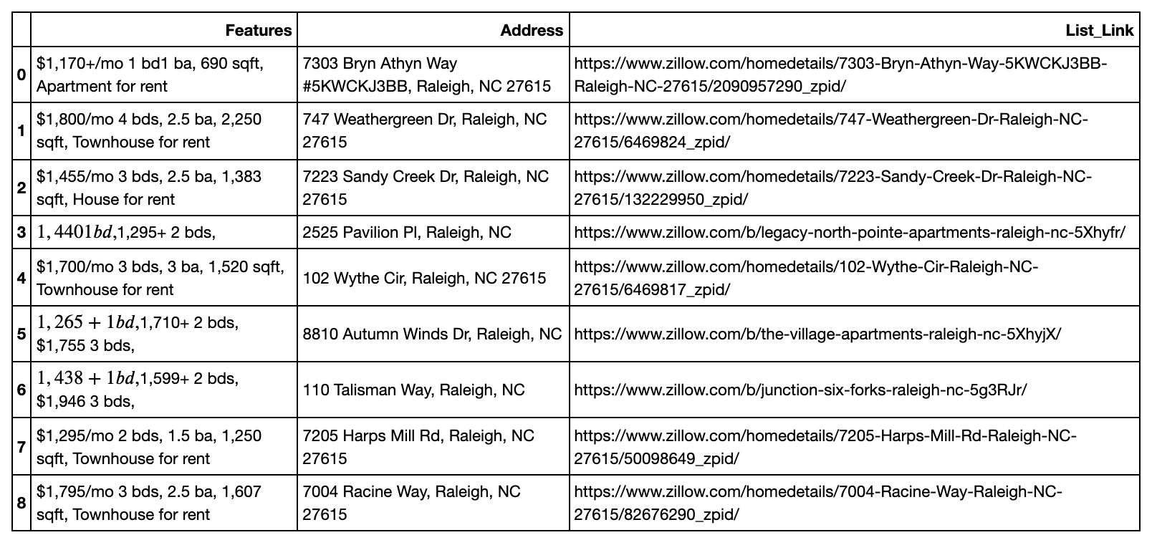
Houses for Rent Nearby Zip 27615

Slide 14
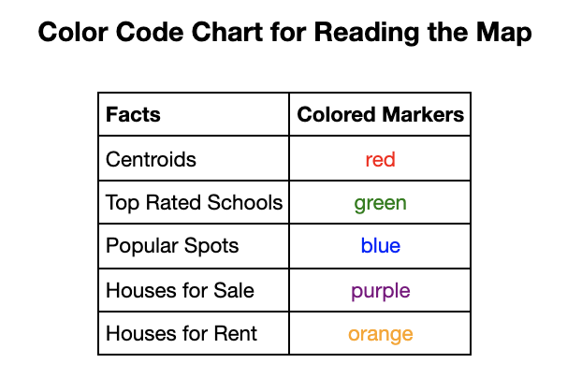
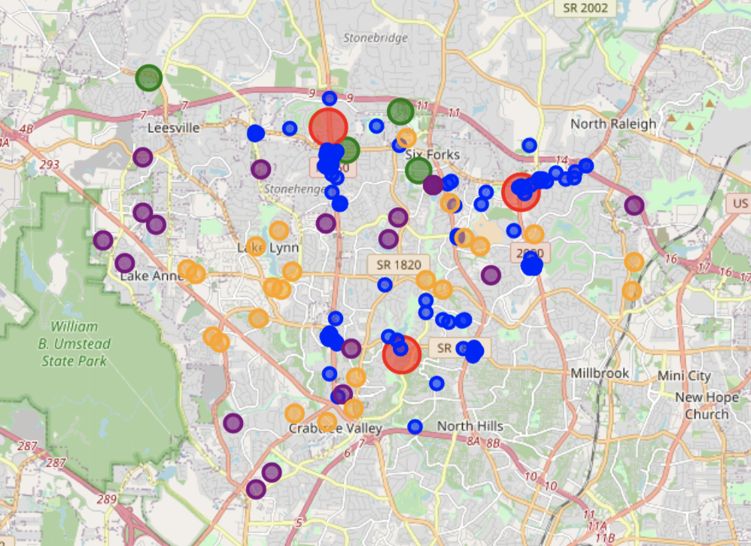
Look at These Houses on the Map

Slide 15
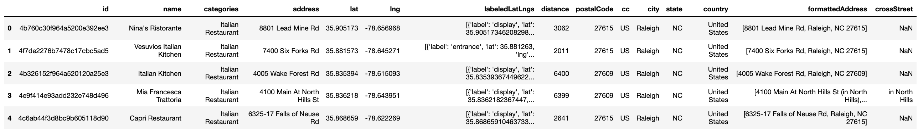
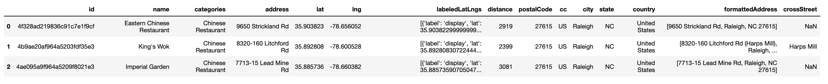
Italian Restaurants and Chinese Restaurants

Slide 16
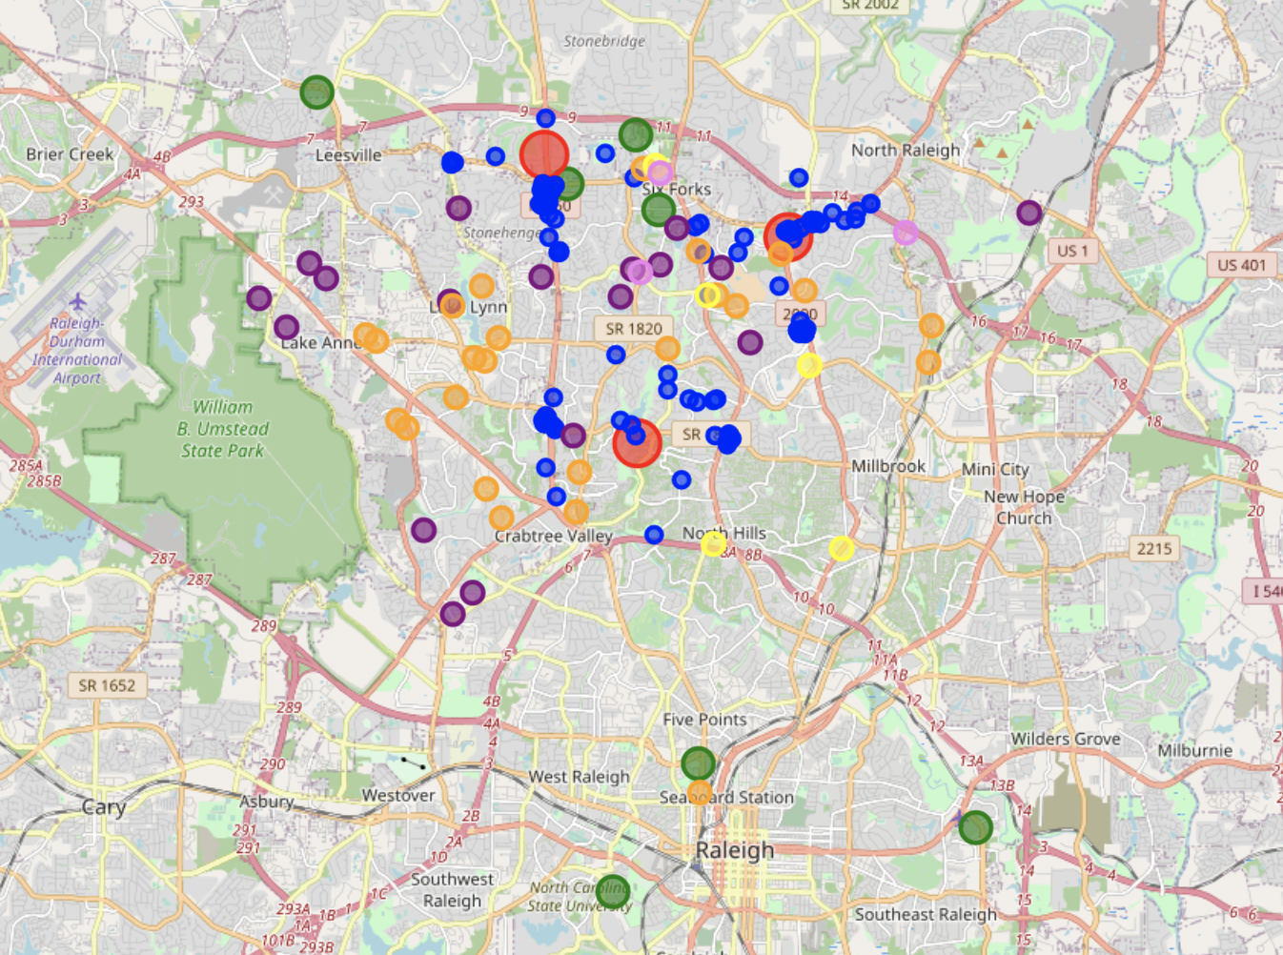
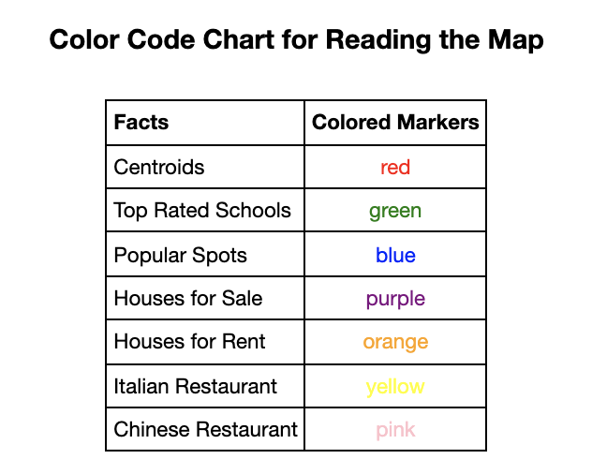
Look at These Restaurants on the Map

Slide 17
Conclusion
The Raleigh city, NC is more optimal city to move to than Atlanta, NC.
Zip 27612, 27613, and 27615 are the most optimal areas to live in.
To be better help more people in the future
Study more cities and compare
Each neighborhood or zip code in the optimal city should be considered for comparison and analysis

